Slide 1
Discrete Mathematics BCSC 0010
Module 2 Propositional logic
(Logical Equivalences)

Slide 2
Translating English Sentences into expressions
"You can access the Internet from campus only if you are a computer science major or you are not a freshman.“
Let a represent "You can access the Internet from campus"
Let c represent "You are a computer science major"
Let f represent "You are a freshman "
a → (c v ~f )

Slide 3
"You cannot ride the roller coaster if you are under 4 feet tall unless you are older than16 years old."
Solution:
Let q represent "You can ride the roller coaster"
Let r represent "You are under 4 feet tall"
Let s represent "You are older than 16 years old"
Then the sentence can be translated to
(r ∧ ~s) →~q.

Slide 4
Propositional Equivalences
A compound proposition that is always true is called a tautology.
A compound proposition that is always false is called a contradiction.
A compound proposition that is neither a tautology nor a contradiction is called a contingency.

Slide 5
Example
Consider the truth tables of p v ~p and p ∧ ~p,
Because p v ~p is always true, it is a tautology.
Because p ∧ ~ p is always false, it is a contradiction.

Slide 6
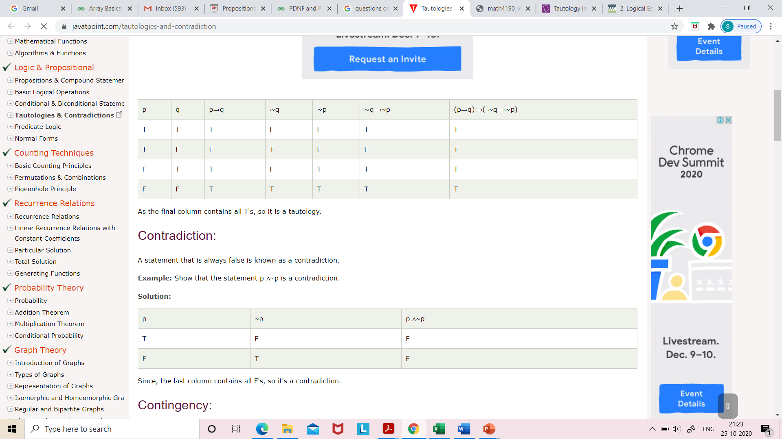
Prove that the statement (p⟶q) ↔ (∼q⟶∼p) is a tautology.

Slide 7
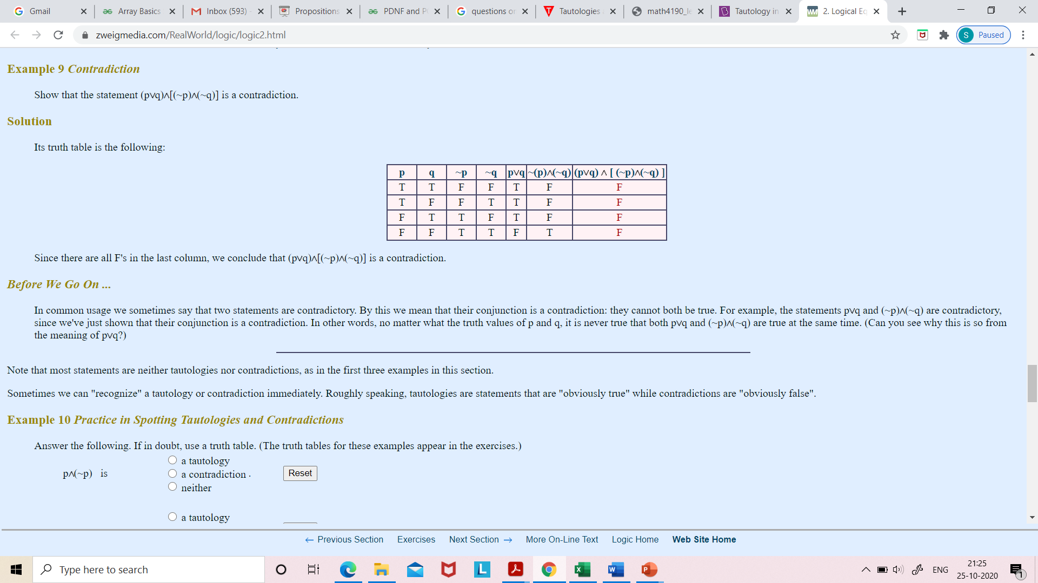

Slide 8
Logical Equivalences
Compound propositions that have the same truth values in all possible cases are called logically equivalent.
The compound propositions p and q are called logically equivalent if
p ↔ q is a tautology.
The notation p ≡ q denotes that p and q are logically equivalent.

Slide 11
Logical equivalences
Two propositions can be proved logically equivalent in two ways:
using Truth tables
using logical identities

Slide 12
Show that ~(p v q) and ~p ∧ ~q are logically equivalent

Slide 13
Show that p → q and ~p v q are logically equivalent

Slide 14
Example

Slide 16
Use De Morgan's laws to express the negation of “John has a cellphone and he has a laptop”
Solution:
Let p be “John has a cellphone" and
q be “John has a laptop."
Then " John has a cellphone and he has a laptop " can be represented by p /\ q.
By the first De Morgan's law, ~(p /\ q) is equivalent to ~p v ~q.
Consequently, we can express the negation of our original statement as
" John does not have a cellphone or he does not have a laptop."

Slide 17
Use De Morgan's laws to express the negation of “John will go to the concert or Steve will go to the concert."
Solution:
Let r be “John will go to the concert" and
s be "Steve will go to the concert."
Then
“John will go to the concert or Steve will go to the concert" can be represented by r v s.
By the second De Morgan's law, ~(r v s) is equivalent to ~r /\ ~s.
Consequently, we can express the negation of our original statement as
“John will not go to the concert and Steve will not go to the concert."

Slide 18
By logical equivalence of conditional statement

Slide 19
Next Topic
Validity of Arguments

